Slide 1
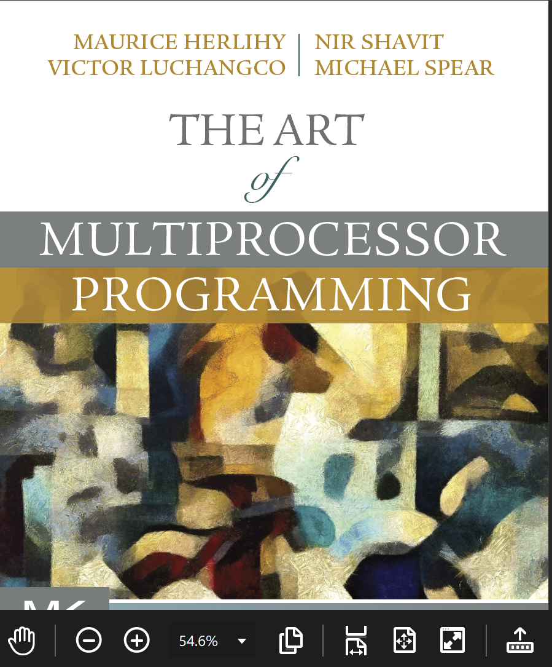
Transactional Memory
Companion slides for
The Art of Multiprocessor Programming
by Maurice Herlihy, Nir Shavit, and Victor Luchangco, Michael Spear
TexPoint fonts used in EMF.
Read the TexPoint manual before you delete this box.: AAAA
Notes:
1

Slide 2
Our Vision for the Future
In this course, we covered ….
Best practices …
New and clever ideas …
And common-sense observations.
Art of Multiprocessor Programming
2
Notes:
2

Slide 3
Our Vision for the Future
In this course, we covered ….
Nevertheless …
Best practices …
Concurrent programming is still too hard …
New and clever ideas …
Here we explore why this is ….
And common-sense observations.
And what we can do about it.
Art of Multiprocessor Programming
3
Notes:
3

Slide 4
Locking
Art of Multiprocessor Programming
4
Notes:
4

Slide 5
Coarse-Grained Locking
Easily made correct …
But not scalable.
Art of Multiprocessor Programming
5
Notes:
5

Slide 6
Fine-Grained Locking
Can be tricky …
Art of Multiprocessor Programming
6
Notes:
6

Slide 7
Locks are not Robust
If a thread holding
a lock is delayed …
No one else can make progress
Art of Multiprocessor Programming
7
Notes:
7

Slide 8
Locking Relies on Conventions
Relation between
Lock bit and object bits
Exists only in programmer’s mind
Actual comment from Linux Kernel
(hat tip: Bradley Kuszmaul)
/*
* When a locked buffer is visible to the I/O layer
* BH_Launder is set. This means before unlocking
* we must clear BH_Launder,mb() on alpha and then
* clear BH_Lock, so no reader can see BH_Launder set
* on an unlocked buffer and then risk to deadlock.
*/
Art of Multiprocessor Programming

Slide 9
Simple Problems are hard
enq(x)
double-ended queue
enq(y)
No interference if ends “far apart”
Interference OK if queue is small
Clean solution is publishable result:
[Michael & Scott PODC 97]
Art of Multiprocessor Programming
9
Notes:
9

Slide 10
Locks Not Composable
Transfer item from one queue to another
Must be atomic :
No duplicate or missing items
Art of Multiprocessor Programming
10
Notes:
10

Slide 11
Locks Not Composable
Lock source
Unlock source & target
Lock target
Art of Multiprocessor Programming
11
Notes:
11

Slide 12
Locks Not Composable
Lock source
Methods cannot provide internal synchronization
Unlock source & target
Objects must expose locking protocols to clients
Lock target
Clients must devise and follow protocols
Abstraction broken!
Art of Multiprocessor Programming
12
Notes:
12

Slide 13
Monitor Wait and Signal
Empty
zzz
buffer
Yes!
If buffer is empty,
wait for item to show up
Art of Multiprocessor Programming
13
Notes:
13

Slide 14
Wait and Signal do not Compose
empty
empty
zzz…
Wait for either?
Art of Multiprocessor Programming
14
Notes:
14

Slide 15

The Transactional Manifesto
Current practice inadequate
to meet the multicore challenge
Research Agenda
Replace locking with a transactional API
Design languages or libraries
Implement efficient run-times
15

Slide 16
Transactions
Block of code ….
Atomic: appears to happen instantaneously
Serializable: all appear to happen in one-at-a-time order
Commit: takes effect (atomically)
Abort: has no effect (typically restarted)
16

Slide 17

Atomic Blocks
atomic { x.remove(3);
y.add(3); } atomic { y = null;
}
17

Slide 18
Atomic Blocks
atomic { x.remove(3);
y.add(3); } atomic { y = null;
}
No data race
18
Notes:
18

Slide 19
A Double-Ended Queue
public void LeftEnq(item x) {
Qnode q = new Qnode(x);
q.left = left;
left.right = q;
left = q;
}
Write sequential Code
19
Notes:
19

Slide 20
A Double-Ended Queue
public void LeftEnq(item x)
atomic {
Qnode q = new Qnode(x);
q.left = left;
left.right = q;
left = q;
}
}
20

Slide 21
A Double-Ended Queue
public void LeftEnq(item x) {
atomic {
Qnode q = new Qnode(x);
q.left = left;
left.right = q;
left = q;
}
}
Enclose in atomic block
21

Slide 22
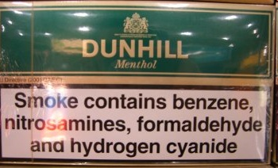
Warning
Not always this simple
Conditional waits
Enhanced concurrency
Complex patterns
But often it is…
22

Slide 23
Composition?
Art of Multiprocessor Programming
23
Notes:
23

Slide 24
Composition?
public void Transfer(Queue<T> q1, q2)
{
atomic {
T x = q1.deq();
q2.enq(x);
}
}
Trivial or what?
Art of Multiprocessor Programming
24
Notes:
24

Slide 25
Conditional Waiting
public T LeftDeq() {
atomic {
if (left == null)
retry;
…
}
}
Roll back transaction and restart when something changes
25

Slide 26
Composable Conditional Waiting
atomic {
x = q1.deq();
} orElse {
x = q2.deq();
}
Run 1st method. If it retries …
Run 2nd method. If it retries …
Entire statement retries
26

Slide 27
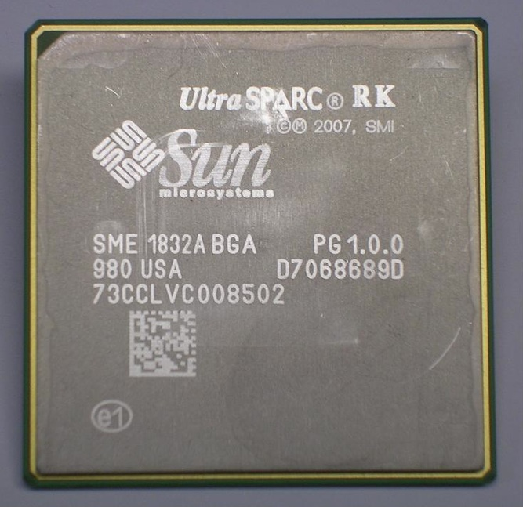

Hardware Transactional Memory
Exploit Cache coherence
Already almost does it
Invalidation
Consistency checking
Speculative execution
Branch prediction = optimistic synch!
Art of Multiprocessor Programming
27
27
Notes:
27
Original TM proposal by Herlihy and Moss 1993…

Slide 28
HW Transactional Memory
read
active
T
caches
Interconnect
memory
Art of Multiprocessor Programming
28
28
Notes:
28

Slide 29
Transactional Memory
read
active
active
T
T
caches
memory
Art of Multiprocessor Programming
29
29
Notes:
29

Slide 30
Transactional Memory
active
committed
active
T
T
caches
memory
Art of Multiprocessor Programming
30
30
Notes:
30

Slide 31
Transactional Memory
write
committed
active
T
D
caches
memory
Art of Multiprocessor Programming
31
31
Notes:
31

Slide 32
Rewind
write
aborted
active
active
T
T
D
caches
memory
Art of Multiprocessor Programming
32
32
Notes:
32

Slide 33
Transaction Commit
Art of Multiprocessor Programming
33
33
At commit point
If no cache conflicts, we win.
Mark transactional entries
Read-only: valid
Modified: dirty (eventually written back)
That’s all, folks!
Except for a few details …
Notes:
33

Slide 34
Hardware Transactional Memory (HTM)
IBM’s Blue Gene/Q & System Z & Power8
Intel’s Haswell TSX extensions
34

Slide 35
Intel RTM
if (_xbegin() == _XBEGIN_STARTED) {
speculative code
_xend()
} else {
abort handler
}

Slide 36
Intel RTM
if (_xbegin() == _XBEGIN_STARTED) {
speculative code
_xend()
} else {
abort handler
}
start a speculative transaction

Slide 37
Intel RTM
if (_xbegin() == _XBEGIN_STARTED) {
speculative code
_xend()
} else {
abort handler
}
If you see this, you are inside a transaction

Slide 38
Intel RTM
if (_xbegin() == _XBEGIN_STARTED) {
speculative code
_xend()
} else {
abort handler
}
If you see anything else, your transaction aborted

Slide 39
Intel RTM
if (_xbegin() == _XBEGIN_STARTED) {
speculative code
_xend()
} else {
abort handler
}
you could retry the transaction, or take an alternative path

Slide 40
Abort codes
if (_xbegin() == _XBEGIN_STARTED) {
speculative code
} else if (status & _XABORT_EXPLICIT) {
aborted by user code
} else if (status & _XABORT_CONFLICT) {
read-write conflict
} else if (status & _XABORT_CAPACITY) {
cache overflow
} else {
…
}

Slide 41
Abort codes
if (_xbegin() == _XBEGIN_STARTED) {
speculative code
} else if (status & _XABORT_EXPLICIT) {
aborted by user code
} else if (status & _XABORT_CONFLICT) {
read-write conflict
} else if (status & _XABORT_CAPACITY) {
cache overflow
} else {
…
}
speculative code can call _xabort()

Slide 42
Abort codes
if (_xbegin() == _XBEGIN_STARTED) {
speculative code
} else if (status & _XABORT_EXPLICIT) {
aborted by user code
} else if (status & _XABORT_CONFLICT) {
read-write conflict
} else if (status & _XABORT_CAPACITY) {
cache overflow
} else {
…
}
synchronization conflict occurred (maybe retry)

Slide 43
Abort codes
if (_xbegin() == _XBEGIN_STARTED) {
speculative code
} else if (status & _XABORT_EXPLICIT) {
aborted by user code
} else if (status & _XABORT_CONFLICT) {
read-write conflict
} else if (status & _XABORT_CAPACITY) {
cache overflow
} else {
…
}
read/write set too big (maybe don’t retry)

Slide 44
Abort codes
if (_xbegin() == _XBEGIN_STARTED) {
speculative code
} else if (status & _XABORT_EXPLICIT) {
aborted by user code
} else if (status & _XABORT_CONFLICT) {
read-write conflict
} else if (status & _XABORT_CAPACITY) {
cache overflow
} else {
…
}
other abort codes …

Slide 45
RTM Execution
if (_xbegin() == _XBEGIN_STARTED)
speculation
_xend()
_xbegin()
_xbegin()
Add to Write Set
Write X
Read X
Add to Read Set
ABORT
Add to Write Set
Write Y
Write Y
Add to Write Set
_xend()
COMMIT
_xend()
Make the change to Y visible
45

Slide 46
RTM
Small & Medium Transactions
Best-effort
Conflicts
Overflow
Unsupported Instructions
Interrupts
Needs software fallback
46

Slide 47
Non-Speculative Fallback
if (_xbegin() == _XBEGIN_STARTED) {
read lock state
if (lock taken) _xabort();
work;
_xend()
} else {
lock->lock();
work;
lock->unlock();
}

Slide 48
Non-Speculative Fallback
if (_xbegin() == _XBEGIN_STARTED) {
read lock state
if (lock taken) _xabort();
work;
_xend()
} else {
lock->lock();
work;
lock->unlock();
}
reading lock ensures that transaction will abort if another thread acquires lock

Slide 49
Non-Speculative Fallback
if (_xbegin() == _XBEGIN_STARTED) {
read lock state
if (lock taken) _xabort();
work;
_xend()
} else {
lock->lock();
work;
lock->unlock();
}
abort if another thread has acquired lock

Slide 50
Non-Speculative Fallback
on abort, acquire lock & do work
(aborting concurrent speculative transactions)
if (_xbegin() == _XBEGIN_STARTED) {
read lock state
if (lock taken) _xabort();
work;
_xend()
} else {
lock->lock();
work;
lock->unlock();
}

Slide 51
Lock Elision
<HLE_Aquire_Prefix> Lock(L)
Atomic region executed as a transaction or mutually exclusive on L
<HLE_Release_Prefix> Release(L)
Execute optimistically, without any locks
Track Read and Write Sets
Abort on memory conflict: rollback acquire lock
51

Slide 52
Lock Elision
<HLE acquire prefix> lock();
do work;
<HLE release prefix> unlock()
52

Slide 53
Lock Elision
<HLE acquire prefix> lock();
do work;
<HLE release prefix> unlock()
first time around,
read lock and
execute speculatively
53

Slide 54
Lock Elision
<HLE acquire prefix> lock();
do work;
<HLE release prefix> unlock()
if speculation fails,
no more Mr. Nice Guy,
acquire the lock
54

Slide 55
Conventional Locks
lock transfer latencies
serialized execution
locks

Slide 56
Lock Elision
locks
lock elision

Slide 57
Lock Teleportation
a
b
c
d

Slide 58
Lock Teleportation
read transaction
a
b
c
d

Slide 59
Lock Teleportation
read transaction
a
b
c
d

Slide 60
Lock Teleportation
no locks acquired
a
b
c
d

Slide 61


Not all Skittles and Beer
Art of Multiprocessor Programming
61
61
Limits to
Transactional cache size
Scheduling quantum
Transaction cannot commit if it is
Too big
Too slow
Actual limits platform-dependent
Notes:
61

Slide 62
HTM Strengths & Weaknesses
Ideal for lock-free data structures

Slide 63
HTM Strengths & Weaknesses
Ideal for lock-free data structures
Practical proposals have limits on
Transaction size and length
Bounded HW resources
Guarantees vs best-effort

Slide 64
HTM Strengths & Weaknesses
Ideal for lock-free data structures
Practical proposals have limits on
Transaction size and length
Bounded HW resources
Guarantees vs best-effort
On fail
Diagnostics essential
Retry in software?

Slide 65
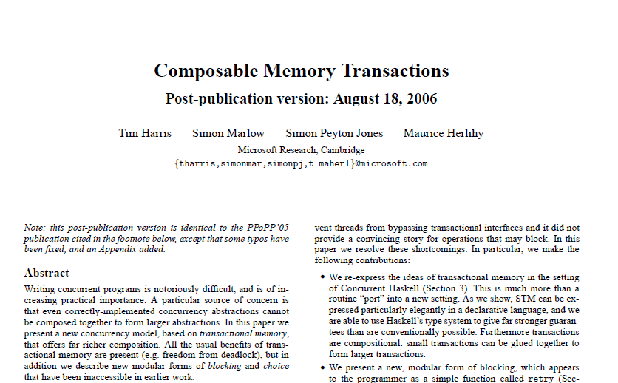
Composition
Locks don’t compose, transactions do.
Composition necessary for Software Engineering.
But practical HTM doesn’t really support composition!
Why we need STM
Notes:
Let’s stop and make a radical shift in view, from low-level hardware to high-level software.
The nice thing about sequential software is that it composes: you don’t need to write your own cosecant function, you can use one from a library, without knowing how it is implemented.
Unfortunately, the same is not true of lock-based synchronization. Given, say, two collections whose methods use locks, you cannot compose them to atomically transfer an item from one to the other!
Transactions, if they can be nested allow you to do Except, if they are HW transactions, because combining two transactions that individually run in HW may exhaust limited HW resources.
This is why we need STM.

Slide 66
Transactional Consistency
Memory Transactions are collections of reads and writes executed atomically
They should maintain consistency
External: with respect to the interleavings of other transactions (linearizability).
Internal: the transaction itself should operate on a consistent state.

Slide 67
External Consistency
Invariant x = 2y
4
X
8
Transaction A:
Write x
Write y
2
Y
4
Transaction B:
Read x
Read y
Compute z = 1/(x-y) = 1/2
Application Memory

Slide 68
A Simple Lock-Based STM
STMs come in different forms
Lock-based
Lock-free
Here : a simple lock-based STM
Lets start by Guaranteeing External Consistency
Notes:
You will be using Deuce: A Java Framework for STM. Added as a library without any modifications to the JVM.

Slide 69
Synchronization
Transaction keeps
Read set: locations & values read
Write set: locations & values to be written
Deferred update
Changes installed at commit
Lazy conflict detection
Conflicts detected at commit

Slide 70
STM: Transactional Locking
Map
V#
Application Memory
Array of version #s & locks
V#
V#
70

Slide 71
Reading an Object
Mem
Locks
V#
Add version numbers & values to read set
V#
V#
V#
V#
71

Slide 72
To Write an Object
Mem
Locks
V#
Add version numbers & new values to write set
V#
V#
V#
V#
72

Slide 73
To Commit
Mem
Locks
Acquire write locks
V#
Check version numbers unchanged
X
V#+1
V#
Install new values
Increment version numbers
V#
Unlock.
V#
Y
V#+1
V#
73

Slide 74
Encounter Order Locking (Undo Log)
Read
Undo Mem Locks
Check unlocked,
add to read set
V# 0
V# 0
V# 0
V# 0
Write
V#+1 0
X
V#+1 0
V# 0
X
V# 1
lock,
add value to write set,
V# 0
V# 0
Y
V#+1 0
V#+1 0
V# 0
Y
V# 1
V# 0
V# 0
Validate
V# 0
V# 0
check read version #s increment write version #s
unlock write set
V# 0
V# 0
V# 0
V# 0
V# 0
V# 0

Slide 75
Commit Time Locking (Write Buff)
Mem Locks
Read
In write set? unlocked?
add value to read set
V# 0
V# 0
V# 0
V# 0
X
V#+1 0
Write
X
V# 1
V# 1
V#+1 0
V# 0
V# 0
add value to write set,
V# 0
V# 0
Validate
Y
V#+1 0
Y
V# 0
V#+1 0
V# 1
V# 1
V#+1 0
V# 0
V# 0
V# 0
acquire locks
check version #s unchanged
install changes,
increment vesion #s, unlock
V# 0
V# 0
V# 0
V# 0
V# 0
V# 0
V# 0
V# 0

Slide 76
Commit Time Locking (Write Buff)
Mem Locks
V# 0
V# 0
V# 0
V# 0
To Read: load lock + location
Location in write-set? (Bloom Filter)
Check unlocked add to Read-Set
To Write: add value to write set
Acquire Locks
Validate read/write v#’s unchanged
Release each lock with v#+1
X
V#+1 0
X
V# 1
V# 1
V#+1 0
V# 0
V# 0
V# 0
V# 0
Y
V#+1 0
Y
V# 0
V#+1 0
V# 1
V# 1
V#+1 0
V# 0
V# 0
V# 0
V# 0
V# 0
V# 0
V# 0
V# 0
V# 0
V# 0
V# 0
Hold locks for very short duration

Slide 77
COM vs. ENC High Load
Red-Black Tree 20% Delete 20% Update 60% Lookup
Hand
COM
ENC
MCS
Notes:
Holding locks long exposes COM to contention. Order of magnitude faster than MCS lock

Slide 78
COM vs. ENC Low Load
Red-Black Tree 5% Delete 5% Update 90% Lookup
Hand
COM
ENC
MCS
Notes:
Hanke 10-12 times faster than lock

Slide 79


Problem: Internal Inconsistency
A Zombie is an active transaction destined to abort.
If Zombies see inconsistent states bad things can happen

Slide 80
Internal Consistency
Invariant: x = 2y
4
x
8
Transaction A: reads x = 4
Transaction B: writes
8 to x, 16 to y, aborts A )
2
y
4
Transaction A: (zombie)
reads y = 4
computes 1/(x-y)
Divide by zero FAIL!
Notes:
Zombie transactiosn are ones that are doomed to fail (here trans will fail validatuon at the end) but go on
Computing in a way that can cause problems

Slide 81
Solution: The Global Clock (The TL2 Algorithm)
Have one shared global clock
Incremented by (small subset of) writing transactions
Read by all transactions
Used to validate that state worked on is always consistent

Slide 82
Read-Only Transactions
Mem
Locks
Copy version clock to local read version clock
12
32
56
19
100
100
17
Shared Version Clock
Private Read Version (RV)
82

Slide 83
Read-Only Transactions
Mem
Locks
Copy version clock to local read version clock
12
Read lock, version #, and memory
32
56
19
100
100
17
Shared Version Clock
Private Read Version (RV)
Art of Multiprocessor Programming
83
83

Slide 84
Read-Only Transactions
Mem
Locks
Copy version clock to local read version clock
12
Read lock, version #, and memory, check version # less than read clock
32
On Commit:
check unlocked & version #s less than local read clock
56
19
100
100
17
Shared Version Clock
Private Read Version (RV)
Art of Multiprocessor Programming
84
84

Slide 85
Read-Only Transactions
Mem
Locks
Copy version clock to local read version clock
12
Read lock, version #, and memory
32
We have taken a snapshot without keeping an explicit read set!
On Commit:
check unlocked & version #s less than local read clock
56
19
100
100
17
Shared Version Clock
Private Read Version (RV)
Art of Multiprocessor Programming
85
85

Slide 86
Example Execution: Read Only Trans
Mem Locks
100
Shared Version Clock
87 0
87 0
87 0
87 0
RV ← Shared Version Clock
On Read: read lock, read mem, read lock: check unlocked, unchanged, and v# <= RV
Commit.
34 0
34 0
34 0
34 0
88 0
88 0
99 0
99 0
99 0
99 0
V# 0
V# 0
44 0
44 0
Reads form a snapshot of memory.
No read set!
50 0
50 0
50 0
50 0
V# 0
V# 0
100
RV

Slide 87
Regular (Writing) Transactions
Mem
Locks
Copy version clock to local read version clock
12
32
56
19
100
100
17
Shared Version Clock
Private Read Version (RV)
Art of Multiprocessor Programming
87
87

Slide 88
Regular Transactions
Mem
Locks
Copy version clock to local read version clock
12
On read/write, check:
Unlocked & version # < RV
Add to R/W set
32
56
19
100
100
17
Shared Version Clock
Private Read Version (RV)
Art of Multiprocessor Programming
88
88

Slide 89
On Commit
Mem
Locks
Acquire write locks
12
32
56
19
100
100
17
Private Read Version (RV)
Shared Version Clock
89

Slide 90
On Commit
Mem
Locks
Acquire write locks
12
Increment Version Clock
32
56
19
100
100
101
17
Private Read Version (RV)
Shared Version Clock
Art of Multiprocessor Programming
90
90

Slide 91
On Commit
Mem
Locks
Acquire write locks
12
Increment Version Clock
Check version numbers ≤ RV
32
56
19
100
100
101
17
Private Read Version (RV)
Shared Version Clock
Art of Multiprocessor Programming
91
91

Slide 92
On Commit
Mem
Locks
Acquire write locks
12
Increment Version Clock
Check version numbers ≤ RV
x
32
Update memory
56
19
100
100
101
y
17
Private Read Version (RV)
Shared Version Clock
Art of Multiprocessor Programming
92
92

Slide 93
On Commit
Mem
Locks
Acquire write locks
12
Increment Version Clock
Check version numbers ≤ RV
x
101
32
Update memory
Update write version #s
56
19
100
100
101
y
101
17
Private Read Version (RV)
Shared Version Clock
Art of Multiprocessor Programming
93
93

Slide 94
Example: Writing Trans
100
120
121
100
Shared Version Clock
Mem Locks
87 0
87 0
87 0
87 0
87 0
RV ← Shared Version Clock
On Read/Write: check unlocked and v# <= RV then add to Read/Write-Set
Acquire Locks
WV = F&I(VClock)
Validate each v# <= RV
Release locks with v# ← WV
X
121 0
X
34 0
34 0
34 1
121 0
34 0
88 0
88 0
121 0
Y
V# 0
Y
99 0
99 0
99 0
99 1
121 0
44 0
44 0
50 0
V# 0
50 0
V# 0
50 0
50 0
50 0
Reads+Inc+Writes
=serializable
100
Commit
RV

Slide 95
Version Clock Implementation
Notice: Version clock rate is a progress concern, not a safety concern...
(GV4) if failed clock CAS use Version Clock set by winner.
(GV5) WV = Version Clock + 2; inc Version Clock on abort
(GV6) composite of GV4 and GV5
Notes:
// Regarding GV4:
// The GV4 form of GVGenerateWV() does not have a CAS retry loop.
// If the CAS fails then we have 2 writers that are racing, trying to bump
// the global clock. One increment succeeded and one failed. Because the 2 writers
// hold locks at the time we bump, we know that their write-sets don't intersect.
// If the write-set of one thread intersects the read-set of the other then we
// know that one will subsequently fail validation (either because the lock
// associated with the read-set entry is held by the other thread, or
// because the other thread already made the update and dropped the lock,
// installing the new version #). In this particular case it's safe if
// two threads call GVGenerateWV() concurrently and they both generate the same
// (duplicate) WV. That is, if we have writers that concurrently try to increment
// the clock-version and then we allow them both to use the same wv. The failing
// thread can "borrow" the wv of the successful thread.
This increases the false+ abort-rate but reduces cache-coherence traffic.
// We only increment _GCLOCK at abort-time and perhaps TxStart()-time.
// The rate at which _GCLOCK advances controls performance and abort-rate.
// That is, the rate at which _GCLOCK advances is really a performance
// concern -- related to false+ abort rates -- rather than a correctness issue.
// CONSIDER: use MAX(_GCLOCK, Self->rv, Self->wv, maxv, VERSION(Self->abv))+2.

Slide 96
TM Design Issues
Implementation choices
Language design issues
Semantic issues

Slide 97
Granularity
Object
managed languages, Java, C#, …
Easy to control interactions between transactional & non-trans threads
Word
C, C++, …
Hard to control interactions between transactional & non-trans threads

Slide 98
Direct/Deferred Update
Deferred
modify private copies & install on commit
Commit requires work
Consistency easier
Direct
Modify in place, roll back on abort
Makes commit efficient
Consistency harder

Slide 99
Conflict Detection
Eager
Detect before conflict arises
“Contention manager” module resolves
Lazy
Detect on commit/abort
Mixed
Eager write/write, lazy read/write …

Slide 100
Conflict Detection
Eager detection may abort transactions that could have committed.
Lazy detection discards more computation.

Slide 101

Contention Management & Scheduling
How to resolve conflicts?
Who moves forward and who rolls back?
Lots of empirical work but formal work in infancy

Slide 102

Contention Manager Strategies
Exponential backoff
Priority to
Oldest?
Most work?
Non-waiting?
None Dominates
But needed anyway
Judgment of Solomon

Slide 103

I/O & System Calls?
Some I/O revocable
Provide transaction-safe libraries
Undoable file system/DB calls
Some not
Opening cash drawer
Firing missile

Slide 104

I/O & System Calls
One solution: make transaction irrevocable
If transaction tries I/O, switch to irrevocable mode.
There can be only one …
Requires serial execution
No explicit aborts
In irrevocable transactions

Slide 105

Exceptions
int i = 0;
try {
atomic {
i++;
node = new Node();
}
} catch (Exception e) {
print(i);
}

Slide 106
Exceptions
Throws OutOfMemoryException!
int i = 0;
try {
atomic {
i++;
node = new Node();
}
} catch (Exception e) {
print(i);
}

Slide 107
Exceptions
Throws OutOfMemoryException!
int i = 0;
try {
atomic {
i++;
node = new Node();
}
} catch (Exception e) {
print(i);
}
What is printed?

Slide 108

Unhandled Exceptions
Aborts transaction
Preserves invariants
Safer
Commits transaction
Like locking semantics
What if exception object refers to values modified in transaction?

Slide 109

Nested Transactions
atomic void foo() {
bar();
}
atomic void bar() {
…
}

Slide 110
Nested Transactions
Needed for modularity
Who knew that cosine() contained a transaction?
Flat nesting
If child aborts, so does parent
First-class nesting
If child aborts, partial rollback of child only

Slide 111


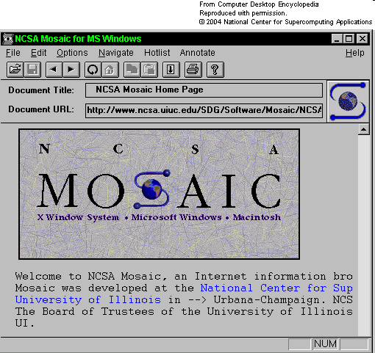
Remember 1993?
Notes:
Remember 1993?
This guy was president.
Hardware news was dominated by the new Pentium processor. Not the Pentium-this or the Pentium-that. Just the Pentium.
Also, there was this new World-Wide-Web thing.
Lost in the noise, Eliot Moss and I published a paper where we proposed something called Transactional Memory as a way to make synchronization easier for multiprocessors (the term "multicore" hadn't yet been invented.) I’ll tell you more about what it is later.
I'm pretty sure the paper got in by the skin of its teeth. At the conference, several PC members congratulated me on getting an "idea paper" into ISCA. In some communities, the term "idea paper" might be a complement, but in ISCA, which tends to fetishize quantitative results, the term, while not exactly fighting words, falls well short of a compliment.

Slide 112
Citation Count
Notes:
When I say "lost in the noise", I am not kidding.
Here is rough count of the number of citations for this paper, gathered from Google Scholar. As you can see, for the first ten years after the paper was published, it languished in obscurity. Early, in the 21st century, however, it got legs.

Slide 113
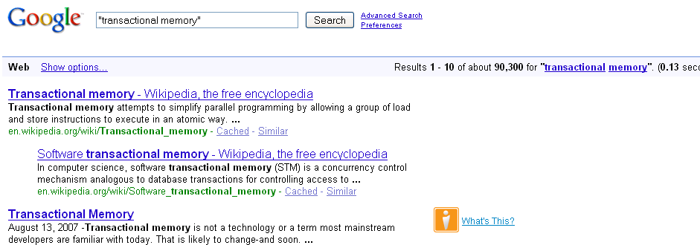
TM Today
93,300
Notes:
Let's look at how much mindshare TM has today.

Slide 114
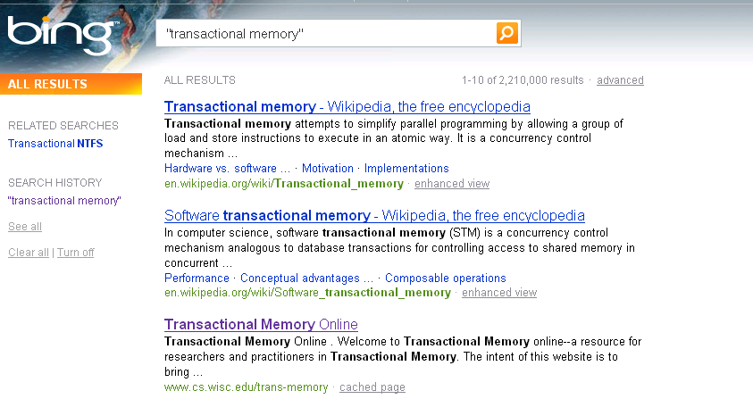
Second Opinion
2,210,000
Notes:
Let’s ask Microsoft for a second opinion.

Slide 115
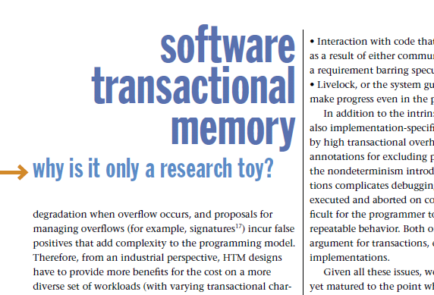
Hatin’ on TM
STM is too inefficient
Notes:
Inexplicably, not everyone thinks TM is all that and more.
Here are some of the common criticisms you will find in published papers and blogs.
Some claim that STM is inherently too inefficient.

Slide 116
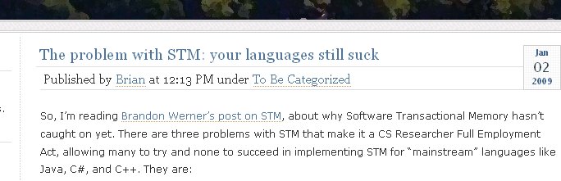
Hatin’ on TM
Requires radical change in programming style
Notes:
Some claim that programmers will never learn to program in a different style.

Slide 117
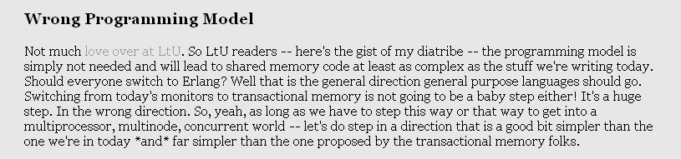
Hatin’ on TM
Erlang-style shared nothing only true path to salvation
Notes:
The sandal-wearing vegetarian Esperanto-speaking faction thinks that shared-memory computation is hopeless, and efforts to improve it are evil.

Slide 118
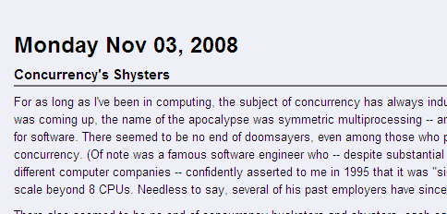
Hatin’ on TM
There is nothing wrong with what we do today.
Notes:
The Austro-Hungarian Empire checks in with the critique that there is nothing wrong with what we do today, do why change?

Slide 119
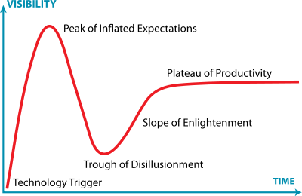
Gartner Hype Cycle
You are here
Hat tip: Jeremy Kemp
Notes:
Long story short, here is my view of the big picture.
Every new technology goes through some form of the “Gartner Hype Cycle”, named after the consulting firm that invented the notion.
An idea is born, and as it becomes known, people expect it to lead them out of the wilderness. Gradually, the community discovers that things are complicated, and that the new technology is not going to pay their mortgages, wash their cars, or solve perpetual motion. A reaction sets in, and some become bitter.
All along, researchers are patiently working on getting the damn thing to work, and eventually the technology settles into a stable, useful mode, less useful than the hype suggested, but better than the haters expect.

Slide 120

I, for one, Welcome our new Multicore Overlords …
Multicore forces us to rethink almost everything

Slide 121
I, for one, Welcome our new Multicore Overlords …
Multicore forces us to rethink almost everything
Standard approaches too complex

Slide 122
I, for one, Welcome our new Multicore Overlords …
Multicore forces us to rethink almost everything
Standard approaches won’t scale
Transactions might make life simpler…

Slide 123
I, for one, Welcome our new Multicore Overlords …
Multicore forces us to rethink almost everything
Standard approaches won’t scale
Transactions might …
Multicore programming
Plenty more to do…
Maybe you will save us…

Slide 124
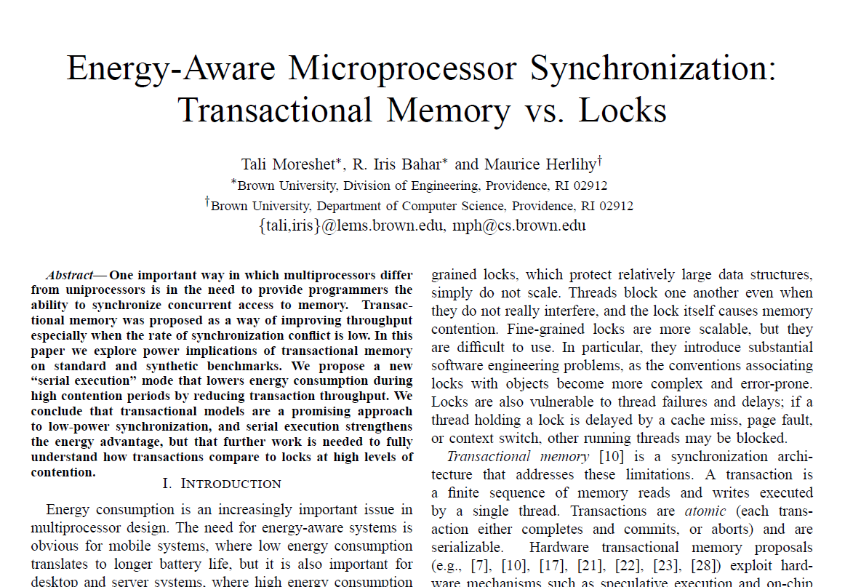
Research

Slide 125

Thanks ! תודה

Slide 126
This work is licensed under a Creative Commons Attribution-ShareAlike 2.5 License.
You are free:
to Share — to copy, distribute and transmit the work
to Remix — to adapt the work
Under the following conditions:
Attribution. You must attribute the work to “The Art of Multiprocessor Programming” (but not in any way that suggests that the authors endorse you or your use of the work).
Share Alike. If you alter, transform, or build upon this work, you may distribute the resulting work only under the same, similar or a compatible license.
For any reuse or distribution, you must make clear to others the license terms of this work. The best way to do this is with a link to
http://creativecommons.org/licenses/by-sa/3.0/.
Any of the above conditions can be waived if you get permission from the copyright holder.
Nothing in this license impairs or restricts the author's moral rights.

